Slide 1
AI-Powered Smart Traffic & Fleet Monitoring System
Project Presentation

Slide 2
Abstract
This project proposes a model that integrates Artificial Intelligence, IoT, and Geospatial Data to improve urban fleet and traffic management. The system enables real-time tracking, intelligent modeling, predictive maintenance, and route optimization. By simulating IoT data and applying basic predictive algorithms, the project demonstrates how AI-powered fleet intelligence can enhance traffic flow and reduce congestion.

Slide 3
Objectives
- To integrate AI, IoT, and Geospatial data for traffic and fleet management.
- To enable real-time spatial tracking of vehicles.
- To provide predictive analysis for traffic congestion.
- To optimize fleet allocation and improve efficiency.

Slide 4
Methodology
- Data Collection (IoT Simulation): Generate vehicle GPS coordinates, speed, and fuel data.
- Geospatial Mapping: Use Google Maps API or simulated maps to visualize fleet movement.
- AI Integration: Apply a simple ML algorithm (like regression/classification) to predict congestion or maintenance needs.
- Visualization Dashboard: Show live vehicle tracking, traffic prediction, and route optimization on a web/desktop app (Java Swing or Web-based).

Slide 5
Features
- Real-time spatial tracking of vehicles.
- Intelligent traffic congestion prediction.
- Dynamic fleet allocation & route planning.
- Predictive maintenance alerts.
- Dashboard for visualization and analysis.

Slide 6
Expected Outcomes
- Efficient monitoring of urban traffic and fleets.
- Reduced congestion through optimized routing.
- Improved safety and reduced downtime with predictive maintenance.
- A scalable model that can extend to smart cities.

Slide 7
Tools & Technologies
- Programming: Java
- Database: MySQL
- Visualization: Java Swing / Web Dashboard
- APIs: Google Maps API (optional)
- AI Models: Regression, Classification, or Clustering
Front end – react

Slide 8
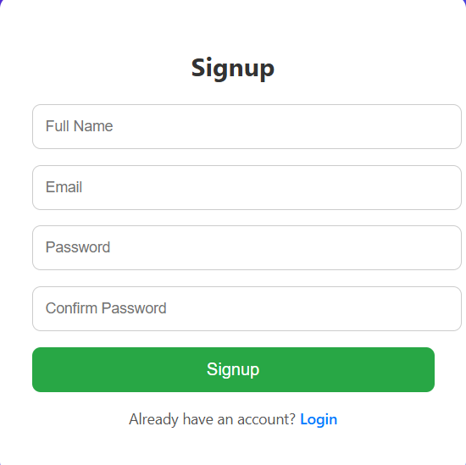
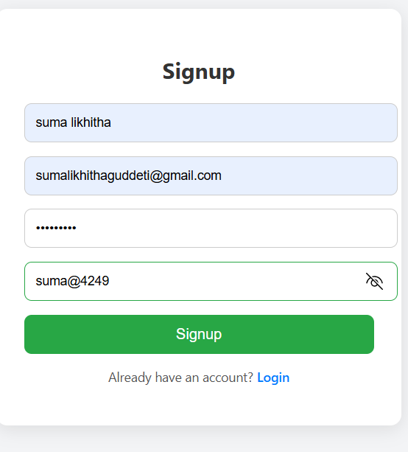
Sign up page

Slide 9
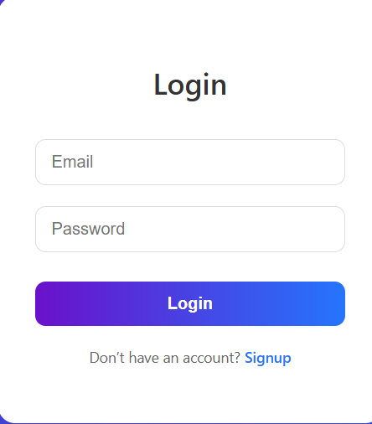
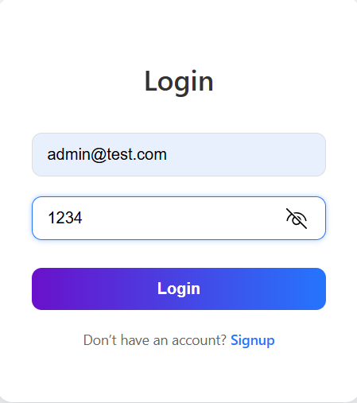
Login Page

Slide 10
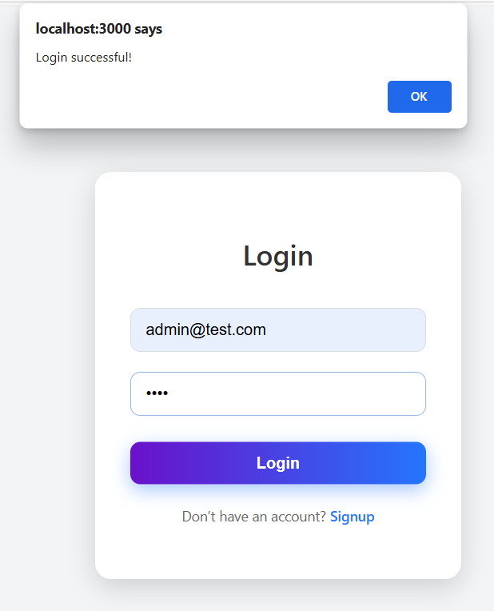
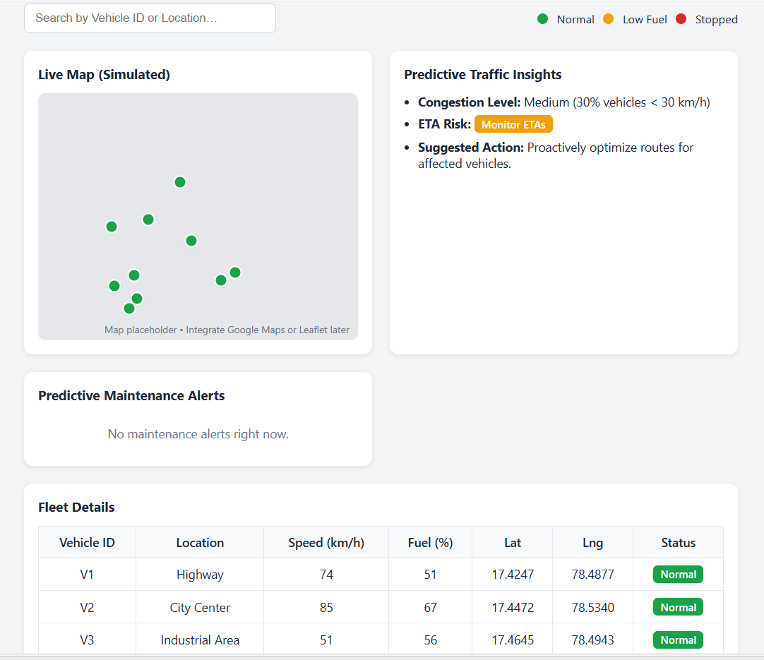
Dashboard (after successful login we get the dashboard as below )

Slide 11
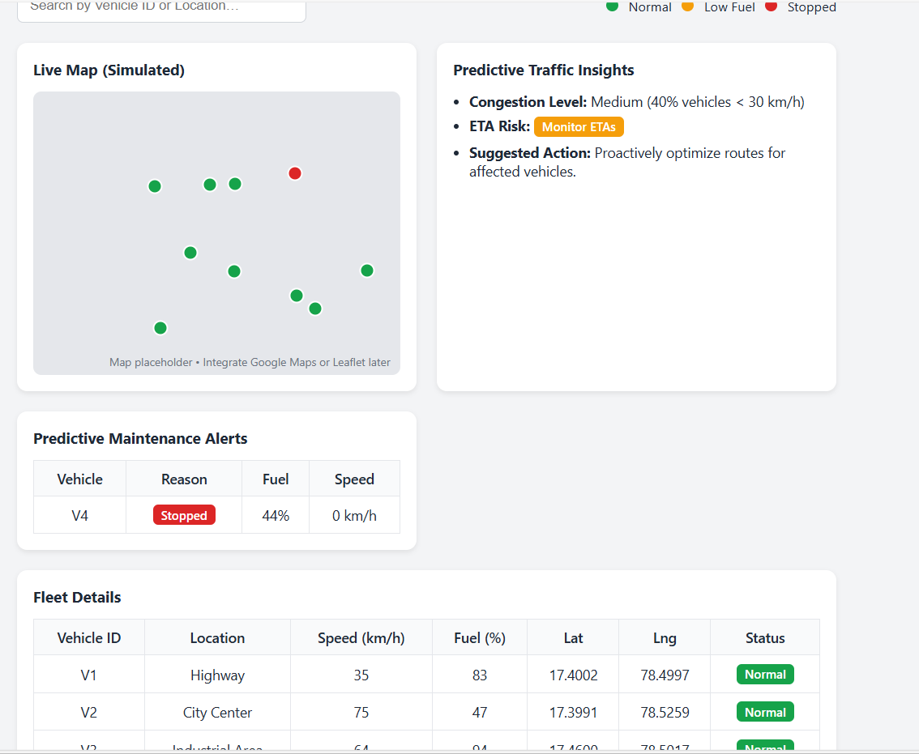
dashboard

